Slide 1


Slide 2

The Problem
GSU shuttles are poorly allocated
Long wait times
Overcrowded buses
Frustrated students

Slide 3
The Solution
An app that incentives riders to check in
Gives GSU data to reallocate buses
Improve rider experience
Create revenue through advertising
Supports local business

Slide 4
What kinds of data will we collect?
Location
Route taken
Time of day check in
Wait time after check in before boarding bus
Driver safety
Bus cleanliness
Overall satisfaction
Student usage
Advertiser data

Slide 5
How will we use this data?
Location data and check in time will show which bus stops are busiest and at which time of day
Route taken and wait time will be used to reallocate buses where they are needed, in real time
Driver safety and bus cleanliness will help administration oversight
Student usage will show if most students are using the app
Advertiser data will be given to companies to create revenue

Slide 6
Implementation of the app
Students who ride the shuttle will download this app with the incentive of waiting less for a ride and getting discounts from local businesses
Currently there is no student data being collected by the university, in reference to the shuttle system although there is an issue with wait times and overcrowded

Slide 7



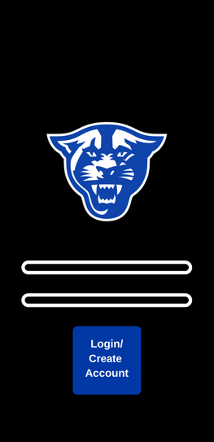
Splash Screen
These are the first 3 screens users will see.
Loading Screen
Login Screen

Slide 8
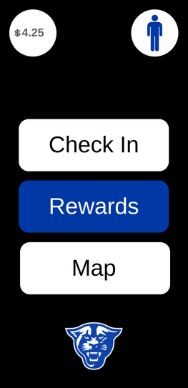
Money/points balance
Profile
This is the main screen.
The panther will
lead back to home
Login Screen

Slide 9
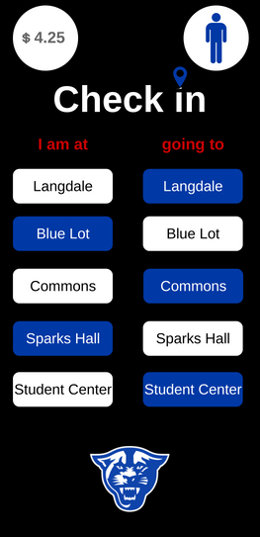
Where the user is
This is the check in screen. Users will report which stop they are waiting at and where they are going.
Where the user is going

Slide 10

The user is thanked for checking in and is given points that go into their account.

Slide 11
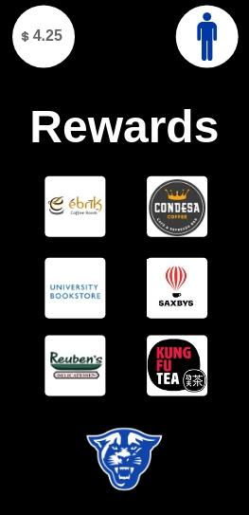
Those points can be redeemed for rewards in the shop, such as discounts at local businesses.

Slide 12
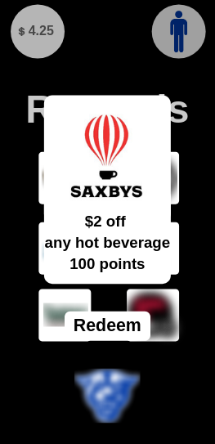
A user can select an icon to see more details on the offer, and choose to redeem the offer with their points.

Slide 13
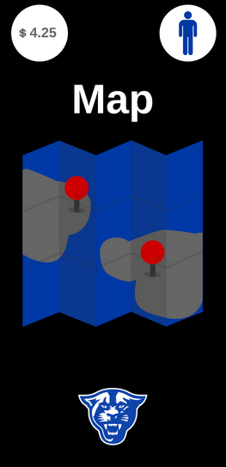
This is where users can view the location of each shuttle on campus.

Slide 14
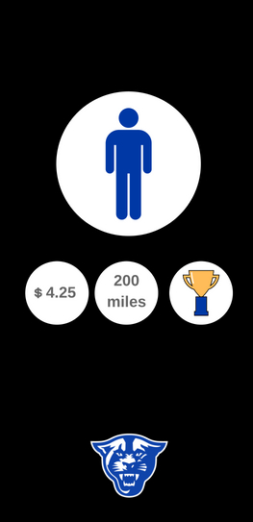
The user can view their points balance, the distance they’ve travelled, and badges earned on their profile.
Badges

Slide 15
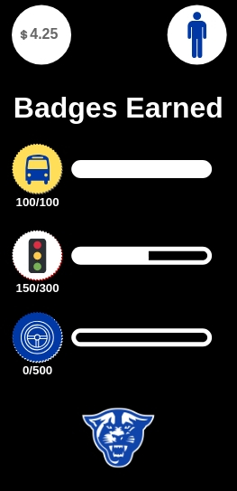
Achievement badges can be earned by checking in on the app and answering quality control questions after the ride is initiated.

Slide 16
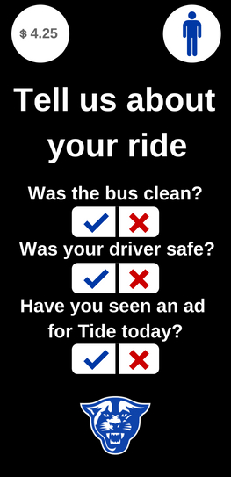
Quality control questions will come up once the accelerometer reaches over 15 mph. Two questions will be in reference to the bus ride, while one will be sponsored to collect user data.

Slide 17
The user is also rewarded for answering these questions.

Slide 18
How does this benefit the city?
Gamification of providing data to benefit the system as a whole could help GSU as a use-case, but could easily be scaled up to be used in any urban landscape. Although every passenger wouldn’t have a smartphone, the data provided by app users would benefit every rider due to less wait times and less crowded buses.

Slide 19
Data – The key to the project
While the app is a fundamental component to this project, the data collection and applications of it are what provide funding, key insights, and utility

Slide 20
Implementation of data system
For this project, we created a Virtual Machine on Google Cloud Platform, and installed Nifi, Elasticsearch, and Kibana, which are all free pieces of software

Slide 21
Elasticsearch
Elasticsearch served as our datastore, so it is where the app would send the different pieces of data that it collects, such as wait time, advertiser interaction, etc.

Slide 22
Nifi
Nifi was used to create tens of thousands of pieces of sample data and write it to elasticsearch, which allowed us to create dashboards and show what the data side would look like with that many app users.

Slide 23
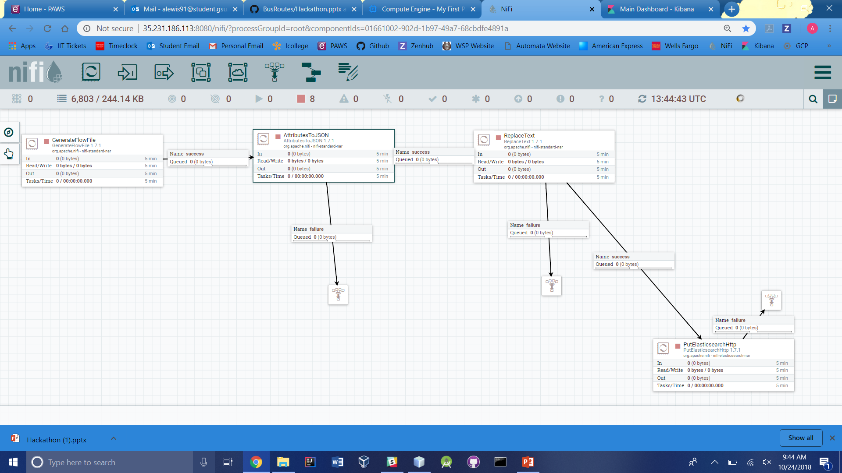
Nifi workflow example

Slide 24
Kibana
Kibana was used to create dashboards based on the data stored in Elasticsearch, and during the time of the hackathon we only had time to make a couple examples, but the possibilities of visualizations and utilizations of the data is endless

Slide 25
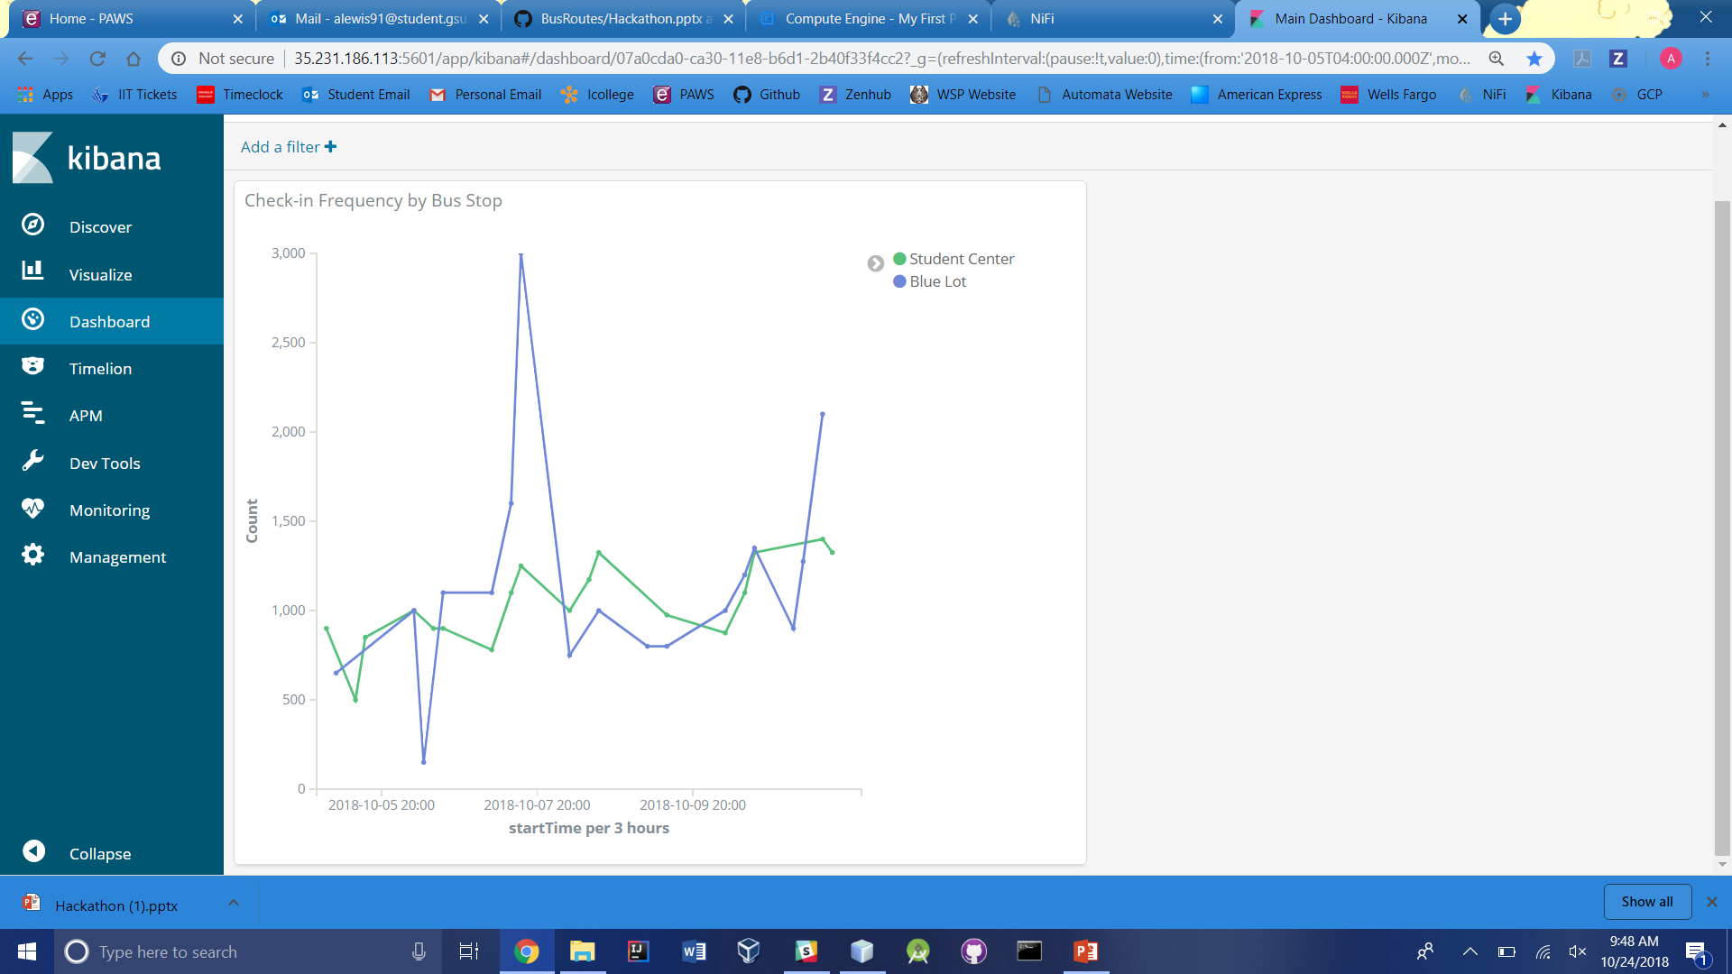
Kibana Dashboard – Tracking bus stop traffic

Slide 26
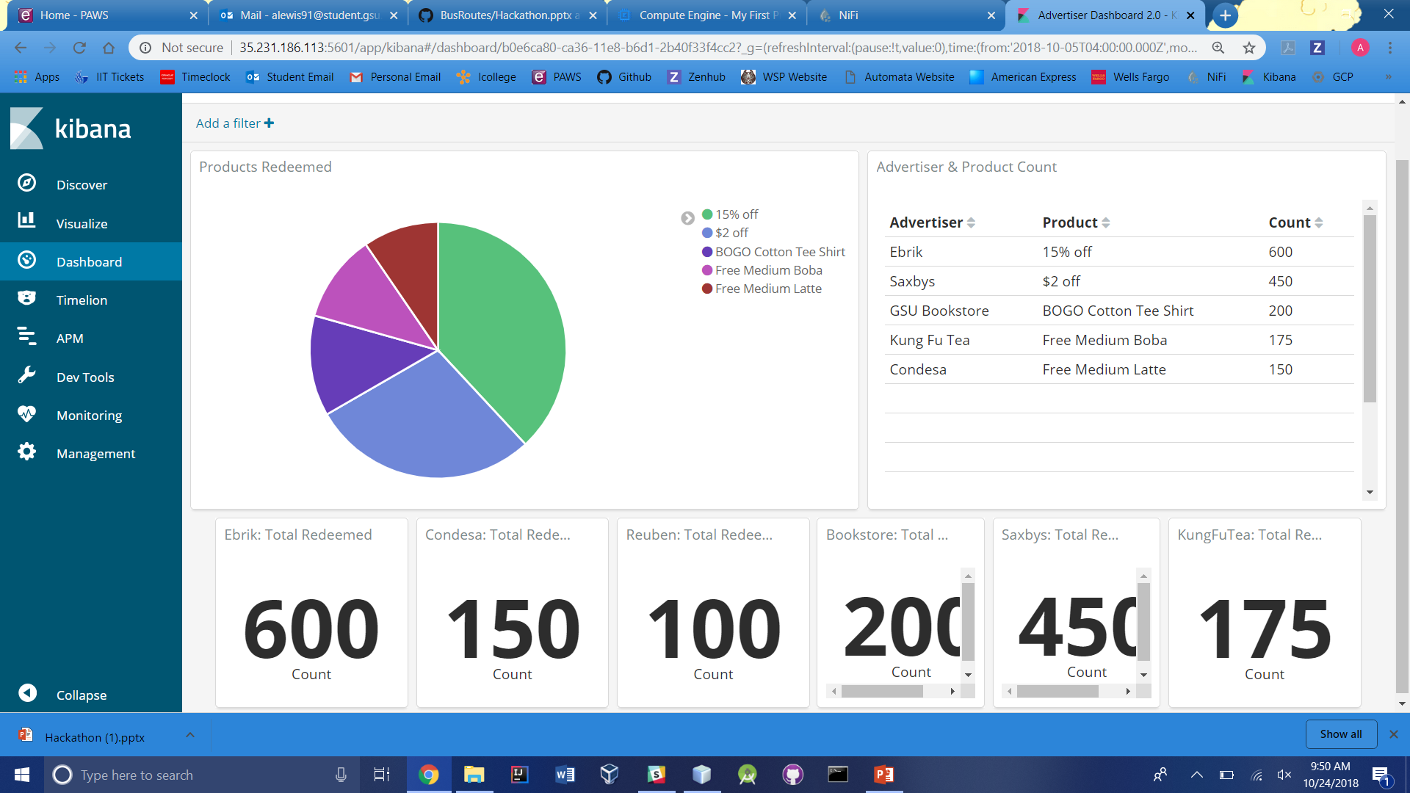
Kibana Dashboard – Tracking advertiser interaction within the app

